Slide 1


The Insight of Entropy in Soccer Matches
Jackson Nahom

Slide 2


Agenda
What is Entropy?
The Data
Application of Entropy
Entropy Results
Machine Learning Models
Conclusion

Slide 3
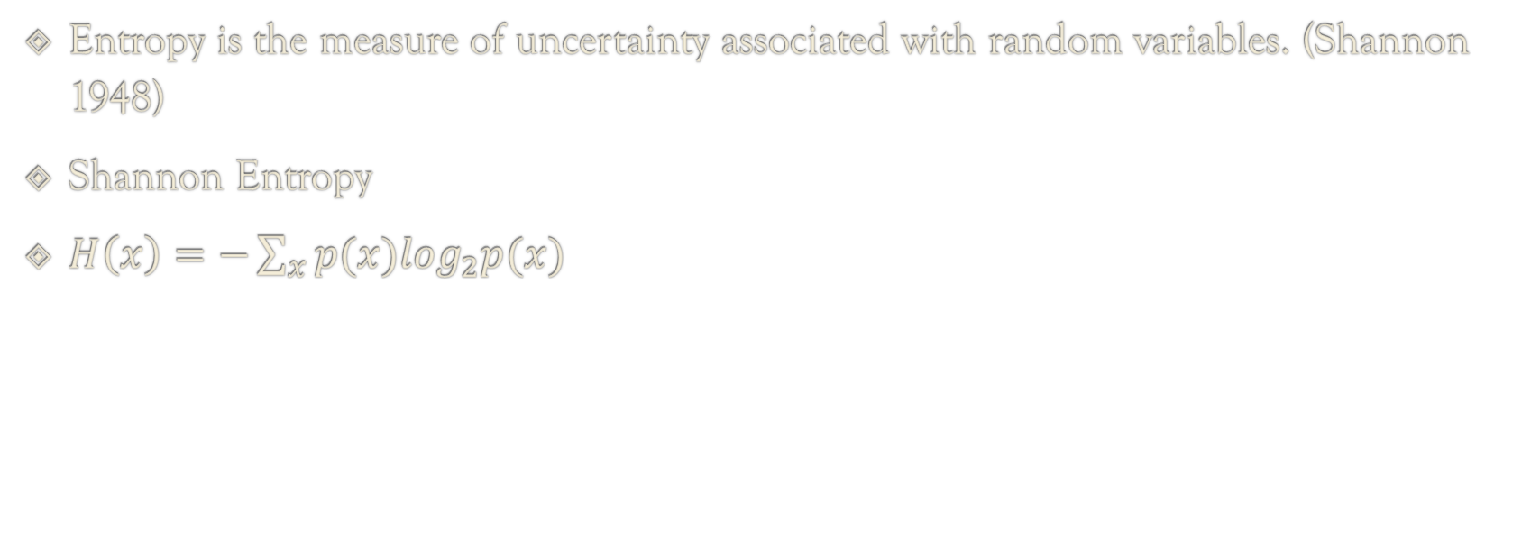
What is Entropy?
Entropy is the measure of uncertainty associated with random variables. (Shannon 1948)
Shannon Entropy
$H\left(x\right)=−\sum_{x}{p(x)\log_{2}p(x)}$

Slide 4

The Data
Event driven data for soccer matches
Events: shots, blocks, passes, interceptions, dribbles, foul committed, clearance, etc.
To use the data we need to weight each event in a way that all the probabilities add up to 0 for each game
Some Events are positive for a team and some are negative
Event | Weight
Pass | 0.05
Shot | 4
Foul Committed | 0.5
Interception | 1.5
Dispossessed | 1
Block | 0.5
Ball Receipt | 0.2
Notes:
{'Starting XI': 0, 'Half Start':0, 'Pass':0.05, 'Ball Receipt*':0.2, 'Carry':0.1, 'Duel':1,
'Ball Recovery':0.5, 'Pressure': 0, 'Miscontrol': 0.1, 'Block': 0.5, 'Interception': 1.5,
'Shot': 4, 'Goal Keeper': 0, 'Clearance': 0, 'Dispossessed': 1, 'Dribble':0,
'Foul Committed': 0.5, 'Foul Won': 0.8, 'Dribbled Past': 2, 'Bad Behaviour': 1,
'Half End': 0, 'Substitution': 0, 'Tactical Shift': 0, 'Error':1, 'Shield': 1 ,
'Referee Ball-Drop': 0, 'Injury Stoppage': 0, '50/50': 0, 'Camera On*': 0,
'Offside': 0, 'Own Goal Against': 0, 'Own Goal For': 0, 'Player On': 0, 'Player Off': 0, 'Camera On': 0, 'Camera off': 0}

Slide 5
How the weighting is done
Take all the events that occur in the game and group them by how many of each event occurs
Multiply the grouping by the weighting to achieve a value for the event
Divide each individual value by the total value the game for a probability for each event
Finally Divide the event probability by the number of occurrences (Individual Probability)

Slide 6

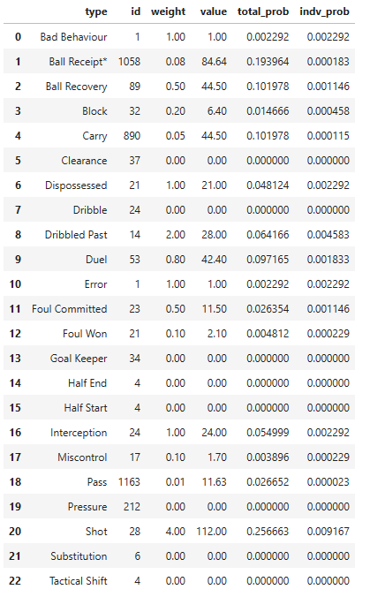
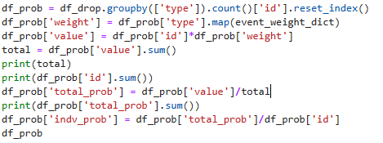
Weighting Code
Teams: Barcelona v Deportivo Alavés
Value Total: 436.37
Number of Events: 3760

Slide 7
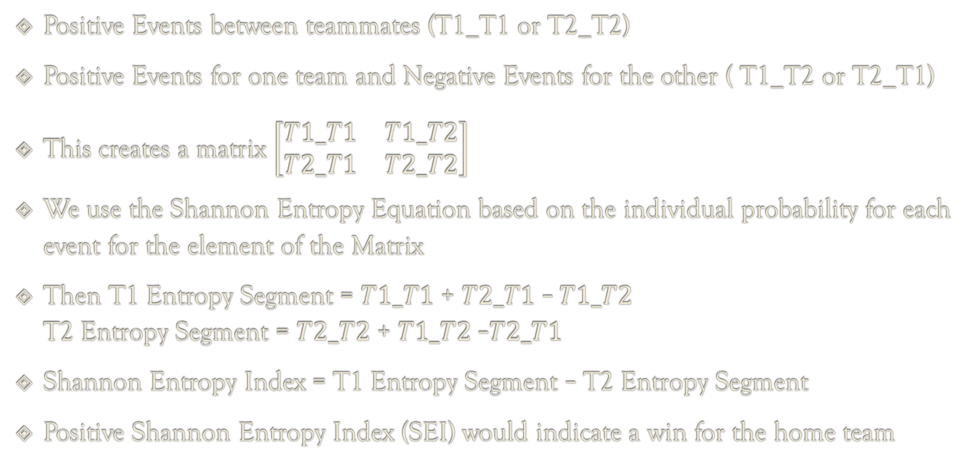
Application of Entropy
Positive Events between teammates (T1_T1 or T2_T2)
Positive Events for one team and Negative Events for the other ( T1_T2 or T2_T1)
This creates a matrix $\left[\begin{matrix}T1_T1 & T1_T2 \\ T2_T1 & T2_T2\end{matrix}\right]$
We use the Shannon Entropy Equation based on the individual probability for each event for the element of the Matrix
Then T1 Entropy Segment = $T1_T1$ + $T2_T1$ – $T1_T2$ $\text{T}\text{2} \text{Entropy} \text{Segment}\text{ = }T2_T\text{2}\text{ + }T1_T\text{2 }\text{–}T2_T1$
Shannon Entropy Index = T1 Entropy Segment – $\text{T}\text{2} \text{Entropy} \text{Segment}$
Positive Shannon Entropy Index (SEI) would indicate a win for the home team

Slide 8
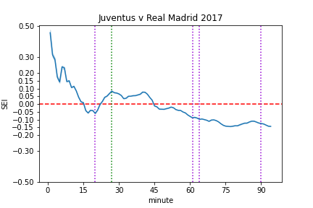

Entropy Through out a Match
Green is Juventus Goals
Purple is Real Madrid Goals
SEI correctly predicted a Real Madrid Win
Entropy application: $current Entropy=Last Row +(−\left(p\left(x\right)\log_{2}p\left(x\right)\right))$

Slide 9
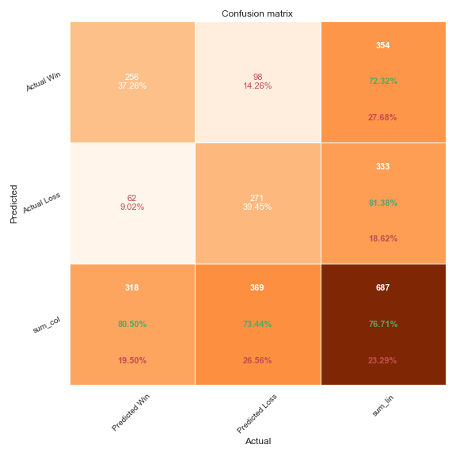
Entropy Results
When we predict a win we are right 80.5% of the time
When we predict not a win we are right 73.44% of the time
Total SEI is correct 76.71% of the time
This includes matches with ties

Slide 10
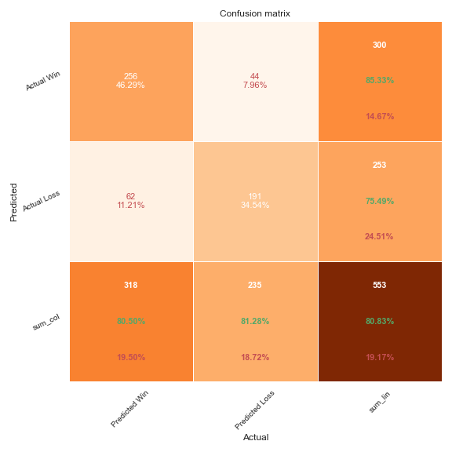
Removing Ties

Slide 11
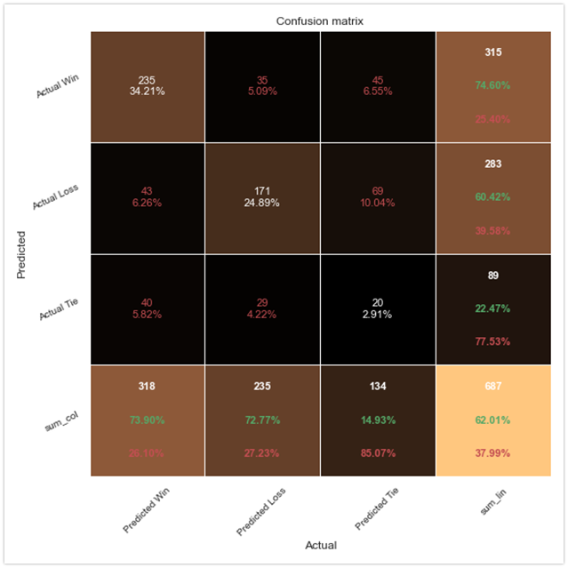
Attempt to Predict Ties

Slide 12
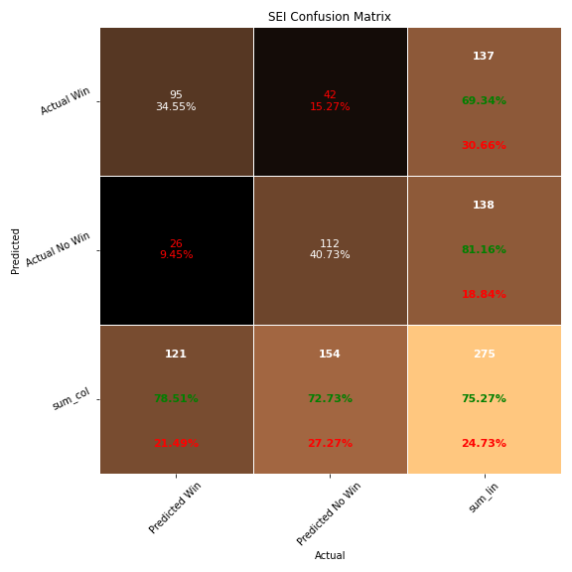
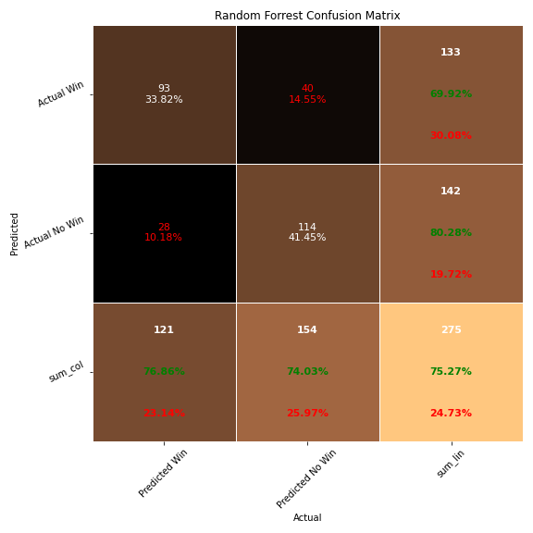
Random Forrest Classifier
Goal was to see if ML models could make a better decision than my SEI
Performed almost Identically as SEI on the same test set
The Features used were: T1_T1, T1_T2, T2_T2, and T2_T1 Entropies

Slide 13
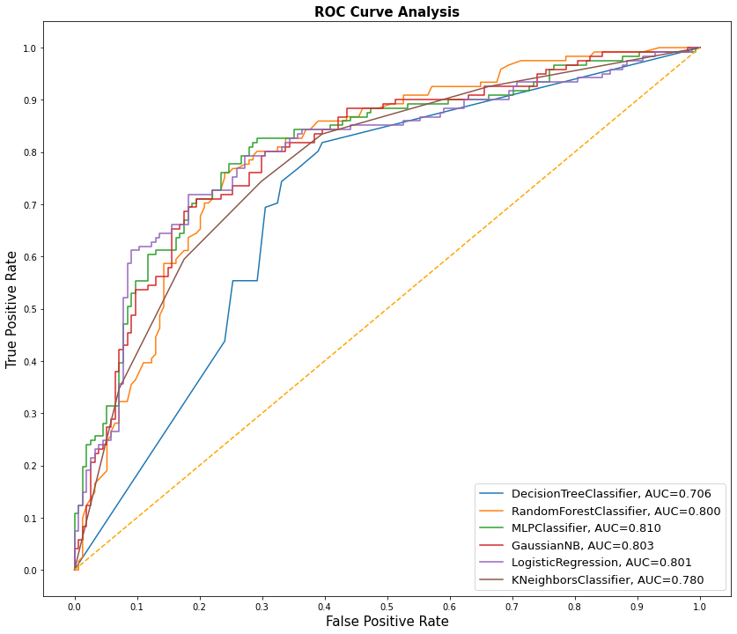
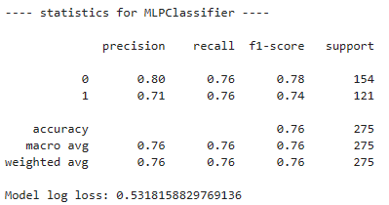
Other Models
Project only looked at 637 Matches so not a lot data when compacted to matches
Best Performing Model according to AUC was MLP

Slide 14
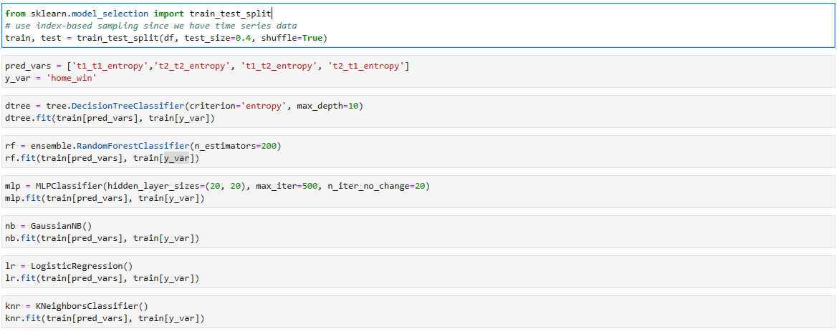
Simple Sklearn Code

Slide 15
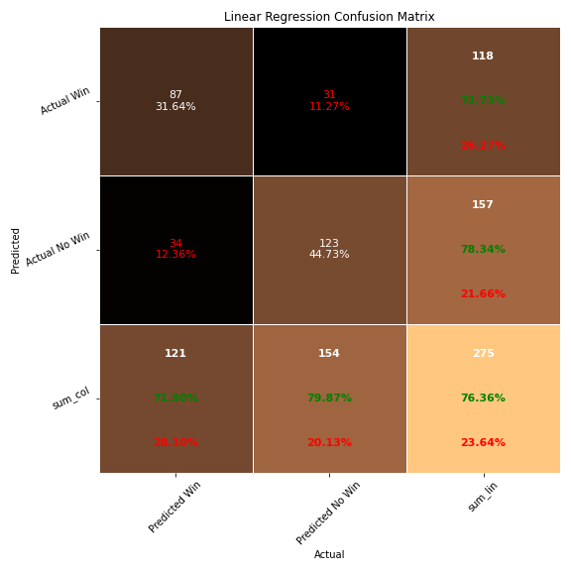
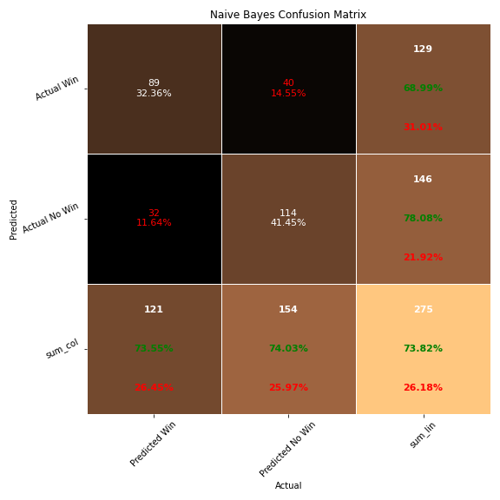


Slide 16
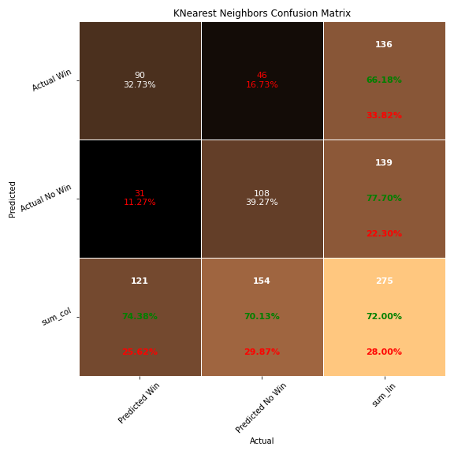
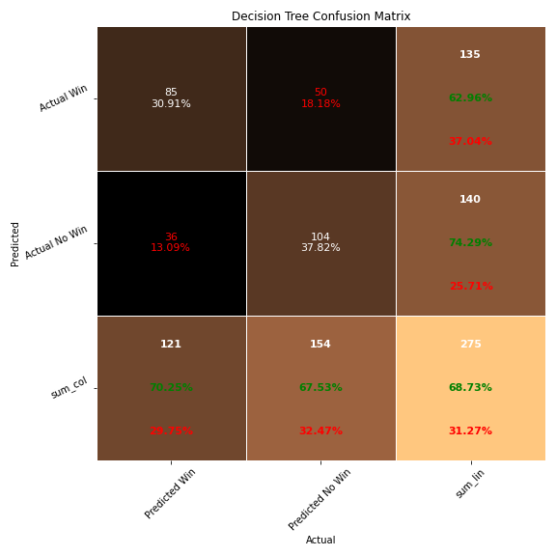

Slide 17
Improvements
Larger Data Set
For the models could have given them some more information, for example the number of times each event happened in a game
Could come up with other Index Types such as KL Distance, Kolmogorov Complexity, or a total activity Index where weighting didn’t matter

Slide 18
Conclusion
Successful
My SEI performed just as well as the ML model with the same information
A lot can be learned just by using the simple Shannon Entropy Equation

Slide 19
Questions?

Slide 20
Sources
C. E. Shannon, “A mathematical theory of communication,” Bell System Technical Journal, vol. 27, no. 3, pp. 379–423, 1948.
https://people.math.harvard.edu/~ctm/home/text/others/shannon/entropy/entropy.pdf
S. Kusmakar, S. Shelyag, Y. Zhu, D. Dwyer, P. Gastin, and M. Angelova, “Machine learning enabled team performance analysis in the dynamical environment of soccer,” IEEE Access, vol. 8, pp. 90266–90279, 2020.
https://ieeexplore.ieee.org/stamp/stamp.jsp?tp=&arnumber=9085411
StatsBomb: https://statsbomb.com/what-we-do/hub/free-data/

Slide 21
GitHub Repo
https://github.com/nahomjd/open-data/tree/working

Slide 22
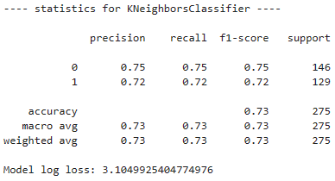
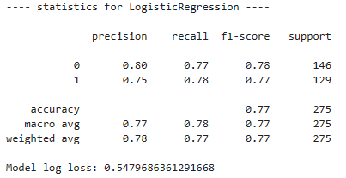
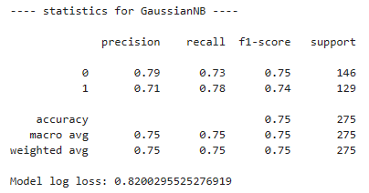
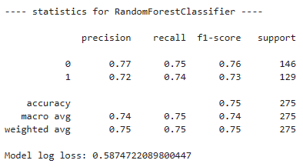
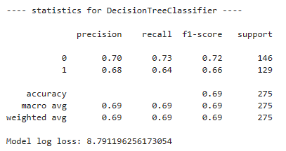
Appendix

Slide 23
Event | Weight | Event | Weight | Event | Weight | Event | Weight
Starting XI | 0 | Block | 0.5 | Dribbled Past | 2 | 50/50 | 0
Half Start | 0 | Interception | 1.5 | Bad Behaviour | 1 | Camera On | 0
Pass | 0.05 | Shot | 4 | Half End | 0 | Offside | 0
Ball Receipt | 0.2 | Goal Keeper | 0 | Substitution | 0 | Own Goal Against | 0
Carry | 0.1 | Clearance | 0 | Tactical Shift | 0 | Own Goal For | 0
Duel | 1 | Dispossessed | 1 | Error | 1 | Player On | 0
Ball Recovery | 0.5 | Dribble | 0 | Shield | 1 | Player Off | 0
Pressure | 0 | Foul Committed | 0.5 | Referee Ball-Drop | 0 | Camera On | 0
Miscontrol | 0.1 | Foul Won | 0.8 | Injury Stoppage | 0 | Camera off | 0

